Slide 1
CS 470 Project Two Conference Presentation: Cloud Development
John Brungard
12/2023

Slide 2
Overview
Introduction:
Name: John Brungard
Role: Software Developer
Purpose of presentation:
Articulate the intricacies of cloud development to both technical and nontechnical audiences.

Slide 3
Containerization
Models used to migrate a full stack application to the cloud:
(5 R’s):Refactor, Replatform, Repurchase, Rehost, and Relocate. (Evangelist, 2023)
Tools necessary for containerization:
Docker
MongoDB

Slide 4
Orchestration
Value of using Docker Compose:
“The big advantage of using Compose is you can define your application stack in a file, keep it at the root of your project repository (it's now version controlled), and easily enable someone else to contribute to your project. Someone would only need to clone your repository and start the app using Compose.” (Use Docker Compose, 2023)

Slide 5
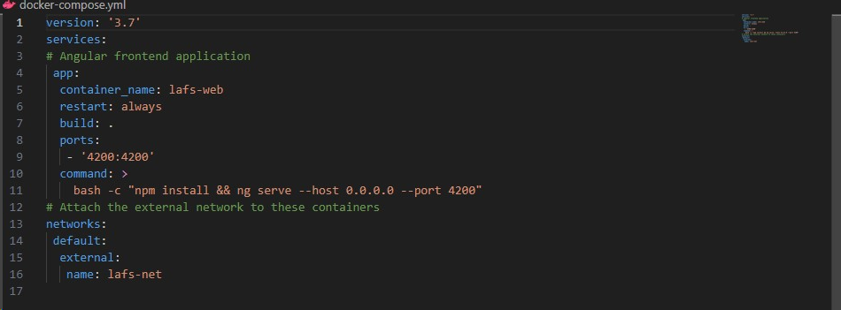
Docker Compose YAML Example

Slide 6
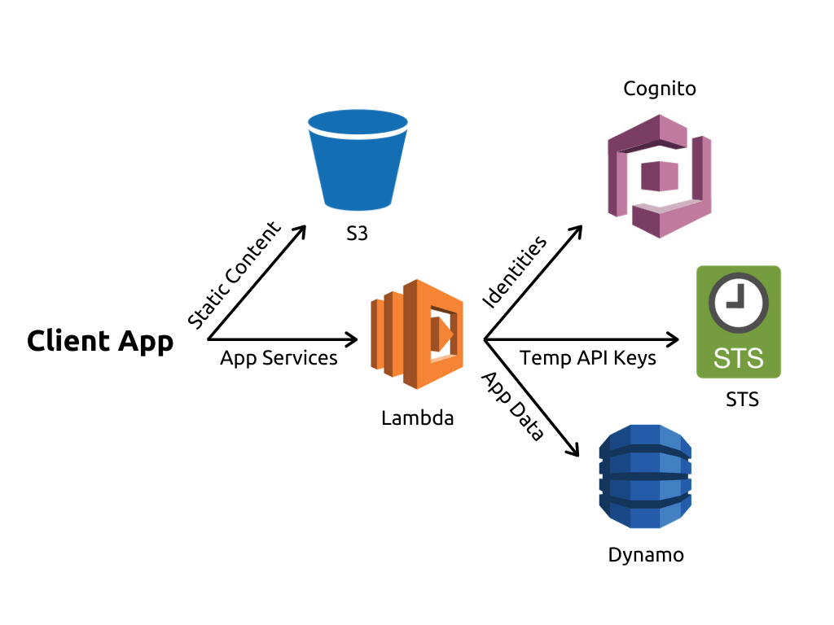
The Serverless Cloud
Serverless
Definition of “serverless” and its advantages:
“Serverless is a cloud-native development model that allows developers to build and run applications without having to manage servers.” (What is serverless, n.d.)
Serverless computing is scalable, can decrease latency, and allows for quick deployments.
What is S3 storage and how does it compare to local storage?
S3 is a storage that provides object storage through web service interface.
When local disc storage crashes or the server associated with it crashes, users do not have access to their files. If a server crashes with AWS S3, you can access your files by running on a backup server and connect to the bucket using your S3 login credentials.
The AWS S3 will likely encounter more latency during file transfers than local storage. This is because after files are uploaded to the server, they still must be forwarded to S3 infrastructure, making a longer path.
(Chak, 2023)

Slide 7
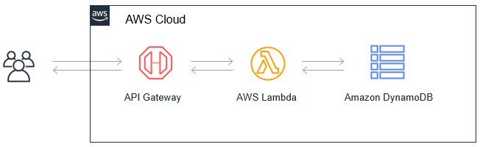
The Serverless Cloud
API & Lambda
Advantages of using a serverless API:
Scalability
Cost
Improved geolocation
Lambda API Logic:
“AWS Lambda executes code in response to AWS service events such as adding/deleting files in an S3 bucket, making an HTTP request to the Amazon API gateway, and so on.”(Jena, 2022)
Script:
Client->Method Request->Integration Request->Lambda Integration ->Proxy Integration->Method Response->Client
Summarize the steps needed to integrate the frontend with the backend.
Create a backend (lafs-web)
Create a frontend (lafs-api)
Make Lambda Functions
Populate and link DynamoDB database
Configure an API using Gateway
Implement Cross Origin Resource Sharing (CORS)
Deploy API.
(Modeling Business Logic Flows in Serverless Applications, 2020)

Slide 8
The Serverless Cloud
Database
Script Snippets
{
"id": "5eb59b7f80433e00045a7dfb",
"categorySlug": "angular",
"questionSlug": "what-is-angular",
"question": "What is Angular",
"negativeVotes": 0,
"positiveVotes": 0,
"answers": []
}
&
{
"answer": "Because it is the backbone of angular“
"negativeVotes": 0,
"positiveVotes": 0,
"id": "5b8629d2af53c20004793ac0",
"questionId": "5eb59b7f80433e00045a7dfb
}
Data-model differences between MongoDB and DynamoDB:
MongoDB can query using single keys, ranges, faceted search, JOINs, graph traversals, and geospatial queries. DynamoDB uses key-value queries only and can have at most 2 attributes. (MongoDB, n.d.)
Queries Performed:
Questions and Answers
Question Example: What is angular?
Answer Example: Because it is the backbone of angular.

Slide 9
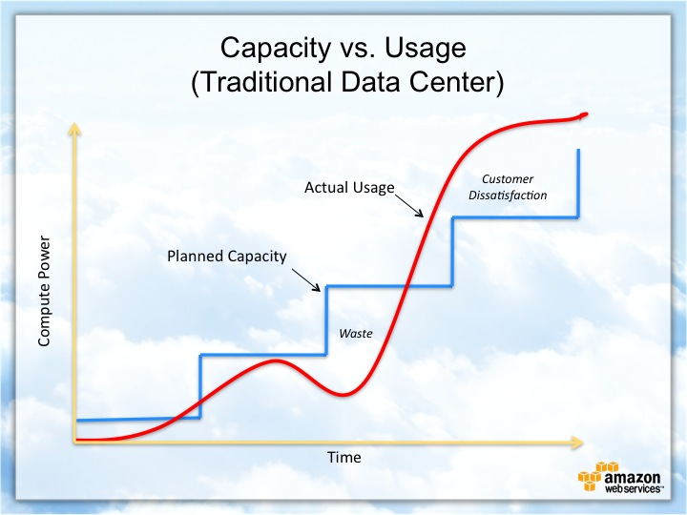
Cloud-Based Development Principles
Elasticity
Elasticity is the ability to manipulate the resources a cloud-based application uses.
Pay-for-use model
The Pay-for-use model does not assign a fixed fee per a certain time iteration. You pay for what resources or compute power you use.

Slide 10
Securing Your Cloud App
Access
How can you prevent unauthorized access?
Encryption: Make data unreadable by unauthorized users by appropriately encrypting it. Encryption keys for data encrypted in the cloud should be managed carefully. AWS provides encryption methods with AWS CloudHSM and AWS KMS.
Tokenization: “Tokenization is a process that allows you to define a sequence of data to represent an otherwise sensitive piece of information (e.g., a token to represent a customer’s credit card number). A token is meaningless on its own and cannot be mapped back to the data it represents without use of the tokenization system. “ (Mitigating Unauthorized Access to Data, n.d.).
Data Decomposition: A process in which data sets are turned into unrecognized elements that have no resemblance to the original data. This makes it so if an unauthorized user accesses a node that it would yield no significance. For an unauthorized user to recover the original data set, one would have to collect all nodes, fragments and know the algorithm to piece the data back to its original form.
Cyber Deception Defense: Cyber Deception is using sophisticated traps and decoys to trick unauthorized users in thinking they have infiltrated the system when they are being monitored and studied to prevent future attempts and to stop the current attempt.

Slide 11
Securing Your Cloud App
Policies
Difference between roles and policies.
“The difference between IAM roles and policies in AWS is that a role is a type of IAM identity that can be authenticated and authorized to utilize an AWS resource, whereas a policy defines the permissions of the IAM identity.” (Magnusson, 2023)
Custom Policies?
No custom policies were implemented due to the use of Lab Role and its permissions.
If lab role was not selected, the custom policy would have used the DynamoDB service and would have selected 6 actions for reading/writing: GetItem, Query, Scan, DeleteItem, UpdateItem, and PutItem.

Slide 12
Securing Your Cloud App
API Security
Secure the connection between Lambda and Gateway:
You can use an HTTP(S) endpoint that your Lambda function can connect to. This allows the API Gateway to forward requests to the corresponding database and work in correlation with Lambda function(s).
You can also use IAM permissions to control access for invoking an API.
Secure the connection between Lambda and the database:
You can use a Virtual Private Cloud (VPC) endpoint if the database is hosted in the same VPC as your Lambda function(s). This can improve security and help with connection interruptions.
You can also use a connection pooling library to manage database connections.
Secure the S3 Bucket
Use S3 Block Public Access.
Disable access control lists (ACLs)
Implement least privilege access

Slide 13
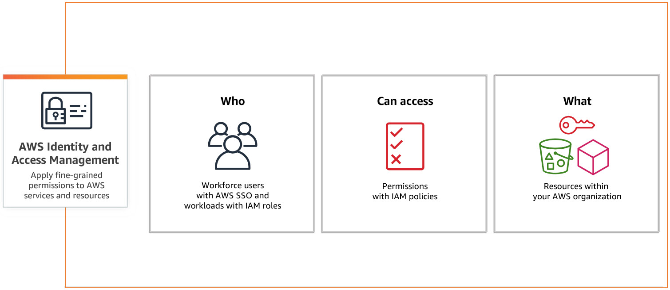
Securing Your Cloud App
(Why Use IAM?, n.d.)

Slide 14
Conclusion
Three Main Points
Use one or more of the following techniques to prevent unauthorized access: encryption, tokenization, data decomposition, and cyber deception.
A serverless API doesn’t mean the application doesn’t have servers. Rather, it means the provisioning is done by the provider instead of the user. This comes with added benefits of scalability, cost (pay-for-use) and the potential for an improved geolocation.
S3 is a storage that provides object storage through web service interface. While it may encounter more latency, users can still retrieve their data when a server crashes unlike local storage.
Thank you for your time.

Slide 15
References
Use docker compose. (2023, November 1). Docker Documentation. https://docs.docker.com/get-started/08_using_compose/#:~:text=Docker%20Compose%20is%20a%20tool,or%20tear%20it%20all%20down.
Evangelist, Y. P. P. (2023, June 1). What is Cloud Migration? Strategy, Process and Tools. https://bluexp.netapp.com/blog/cloud-migration-strategy-challenges-and-steps#:~:text=There%20are%20seven%20cloud%20migration,repurchasing%2C%20retiring%2C%20and%20retaining.
What is serverless? (n.d.). https://www.redhat.com/en/topics/cloud-native-apps/what-is-serverless#:~:text=Evolution%20of%20serverless-,Overview,abstracted%20away%20from%20app%20development.
Chak, Z. (2023, September 6). What is Serverless? | Just After Midnight. Just After Midnight. https://www.justaftermidnight247.com/insights/what-is-serverless/
Jena, M. (2022, December 29). Understanding AWS Lambda: The Definitive Guide Simplified 101. Learn | Hevo. https://hevodata.com/learn/understanding-aws-lambda/#working
Mitigating unauthorized access to data. (n.d.). https://docs.aws.amazon.com/whitepapers/latest/logical-separation/mitigating-unauthorized-access-to-data.html
Magnusson, A. (2023, November 6). Understanding the Difference Between IAM Roles and Policies in AWS. strongdm. https://www.strongdm.com/blog/aws-iam-roles-vs-policies#:~:text=The%20difference%20between%20IAM%20roles%20and%20policies%20in%20AWS%20is,permissions%20of%20the%20IAM%20identity.
MongoDB. (n.d.). Comparing DynamoDB And MongoDB. https://www.mongodb.com/compare/mongodb-dynamodb
Why use IAM? (n.d.). [Video]. Amazon Web Services, Inc. https://aws.amazon.com/iam/

